Slide 1
Operating System
Dr. Kaushal Shah
Assistant Professor
Computer Engineering
PDEU
The compilation of the PPTs is from the source:
All the different articles and research papers available on internet and NPTEL

Slide 2
Outline for Today
History of OS
Types of OS

Slide 3
Parts of OS
No universal agreement on the topic, but most likely
Memory Management
IO Management
CPU Scheduling
IPC
MultiTasking/Multiprogramming
(On some Operating System, this functionality is provided by a single program known as the kernel)

Slide 4
Parts of OS (Contd.)
What about?
File System
Multimedia Support
UI (X Windows, MSWin)
Internet Browser?
Why would extras be important

Slide 5
Evolution
First Generation: Punched cards
Second Generation: Transistors and batch systems.
Third Generation: (Integrated Circuits)
Spooling
Multiprogramming
Multitasking
Virtual Memory

Slide 6
Spooling
Stands for Simultaneous Peripheral Operation On-Line
Takes advantage of disk technology (new at this point)
Allows for overlap of IO from one job with the computation of another job
While executing current job
Read next job from card reader to disk
Print previous job to printer
Disk is relegated to the role of a partitioned buffer

Slide 7
Job pool
Advent of disk allows for random access
(Tape and card are sequential)
Several jobs can be waiting on the disk
The job pool is a data structure that contains info and points to the jobs on the disk
We can now have job scheduling to determine the order in which the jobs run so that CPU utilization can increase.

Slide 8
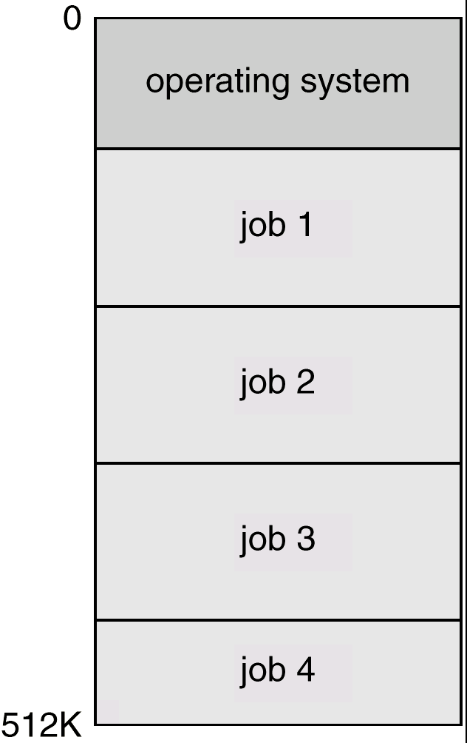
Multiprogramming
Memory partitioned into several pieces
CPU Starts a job
If the job is waiting for IO, the CPU can switch to another task

Slide 9
Multitasking (Time-sharing)
Extension of Multiprogramming
Need for user interactivity
Instead of switching jobs when waiting for IO, a timer causes jobs to switch
User interacts with computer via CRT and keyboard
Systems have to balance CPU utilization against response time
Better device management
Need for file system to allow user to access data and code
Need to provide user with an “interaction environment”

Slide 10
Virtual Memory
Programs can be larger than memory
Program loaded into memory as needed
Active program and data “swapped” to a disk until needed
Memory space treated uniformly

Slide 11
Key Events 3rd Generation
1964-1966 IBM/360 and OS/360
1964 Dartmouth Time Sharing System
1965 DEC PDP-8
1965 MIT – Multics Time sharing System
1969 – Beginnings of ARPANet
1969 - Unix
1971 IBM 4001 – Processor on a chip
1973 – Ethernet concept Bob Metcalf @ Xerox Parc
1974 - Gary Kildall – CP/M OS
1974 Zilog Z80 Processor

Slide 12
Key Events (Contd.)
1974 - Edward Roberts, William Yates and Jim Bybee
MITS Altair 8800.
$375
contained 256 bytes of memory
no keyboard, no display, and no aux storage device.
1976 Steve Jobs and Steve Wozniak
Apple II
1977 Commodore PET, Radio Shack TRS_80
1979 Unix 3BSD

Slide 13
Fourth Generation : (1980 – 1990)
Personal Computers
Computer dedicated to a single user
IO Devices now consist of keyboards, mice, CGA-VGA displays, small printers
User convenience and responsiveness
Can adopt lessons from larger operating systems
No need for some of the advanced options at the personal level

Slide 14
Key Events 4th Generation
1981 IBM PC (8086)
1981 Osborne 1
1981 Vic 20
1981 Xerox Star Workstation
1984 Apple macintosh
1984 SunOS
1985 C++
1985 MSWindows
1986 – 386 Chip

Slide 15
Key Events 4th Generation (cont)
1987 OS/2
1988 Next Unix Workstations
1989 Motif
1990 Windows 3,
1990 Berners-Lee Prototype for the web

Slide 16
5th Gen Parallel Systems
Multiprocessor systems with more than one CPU in close communication.
Tightly coupled system – processors share memory and a clock; communication usually takes place through the shared memory.
Advantages of parallel system:
Increased throughput
Economical
Increased reliability
graceful degradation
fail-soft systems

Slide 17
Parallel Systems (Cont.)
Symmetric multiprocessing (SMP)
Each processor runs an identical copy of the operating system.
Many processes can run at once without performance deterioration.
Most modern operating systems support SMP
Asymmetric multiprocessing
Each processor is assigned a specific task; master processor schedules and allocates work to slave processors.
More common in extremely large systems

Slide 18
Real-Time Systems
Often used as a control device in a dedicated application such as controlling scientific experiments, medical imaging systems, industrial control systems, and some display systems.
Well-defined fixed-time constraints (known as deterministic).
Hard real-time system.
Secondary storage limited or absent, data stored in short-term memory, or read-only memory (ROM)
Conflicts with time-sharing systems, not supported by general-purpose operating systems.
Soft real-time system
Limited utility in industrial control or robotics
Useful in applications (multimedia, virtual reality) requiring advanced operating-system features.

Slide 19
Distributed Systems
Distribute the computation among several physical processors.
Loosely coupled system – each processor has its own local memory; processors communicate with one another through various communications lines, such as high-speed buses or telephone lines.
Advantages of distributed systems.
Resources Sharing
Computation speed up – load sharing
Reliability
Communications

Slide 20
Distributed Systems (Cont.)
Network Operating System
provides file sharing
provides communication scheme
runs independently from other computers on the network
Distributed Operating System
less autonomy between computers
gives the impression there is a single operating system controlling the network.

Slide 21
Why Operating Systems?
OS for CSE :
Real world OS is a software engineering problem
Design of the Virtual/Extended machine
Development of the Kernel
OS Usability, Human Factors for OS
OS for CSE:
New algorithms to help make OS better, more efficient
Hypothesis, experiments regarding OS approaches
OS for anyone else :
Help to understand better the parts of the OS and how to compare and contrast the various qualities of Operating Systems

Slide 22
Questions???

